Slide 1
Welcome

Slide 2
DOUBLE STORIED 3D HOUSE

Slide 3


Team Members
Team
Md. Nur A Neouse
ID: 193002093
Md. Jakirul Islam
Study Nests
ID: 193002101

Slide 4
Introduction of Topic
Motivation
Objectives
Tools and Measurements
Steps

Slide 5
Motivation
The topic we chose was Architectural. Our group chose this topic because we thought it would benefit us most. Architectural drawings are used throughout day to day life whether you’re a contractor, civil engineer, architect, or a home owner. It’s important to understand the ins and outs of how architectural drawings work.

Slide 6
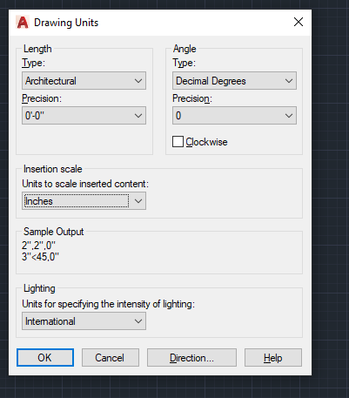
Tools and Measurements
Software:
Here, I use AutoCAD 2019 version for my design .
Units:
The length type is Architectural, precision is
(0’-0’’).The units to scale inserted content is
Inches & units for specifying the intensity of
Lighting is International.

Slide 7
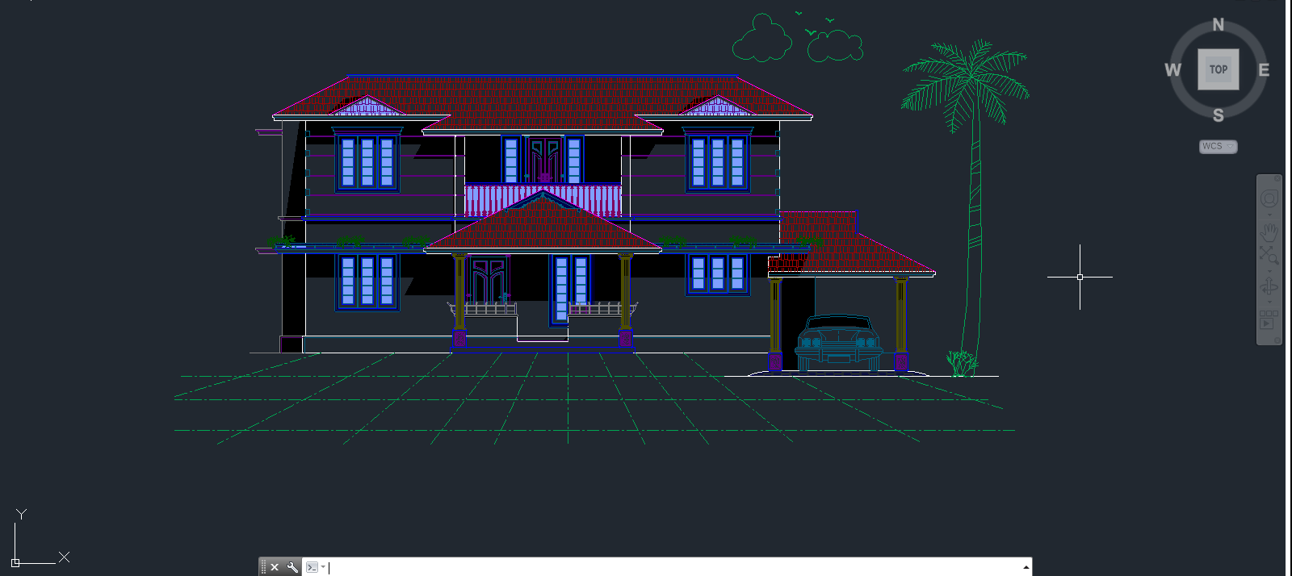
Steps
DOUBLE STORIED 3D HOUSE

Slide 8
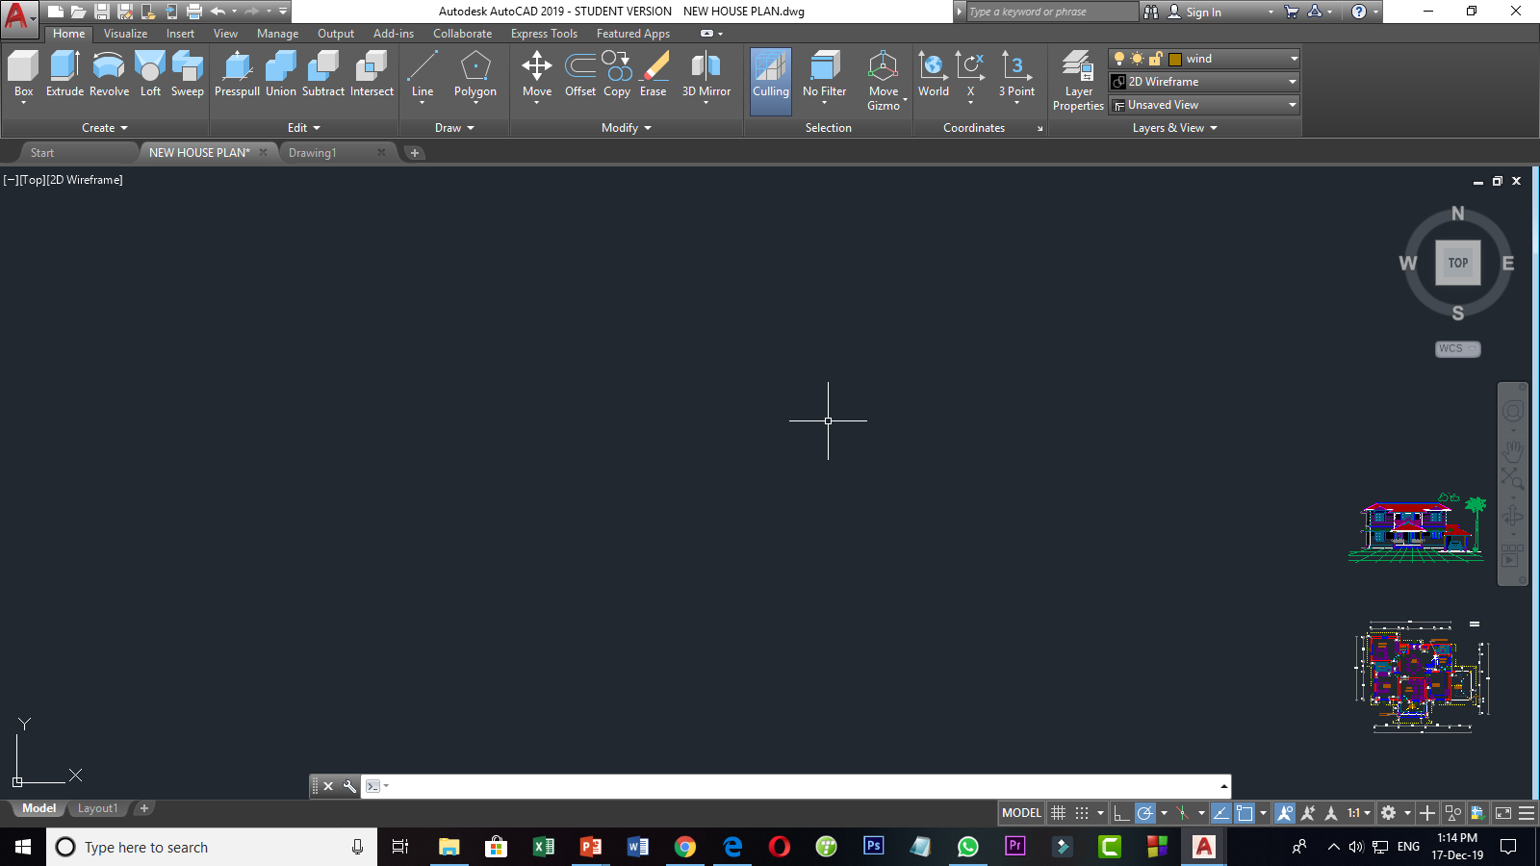
Step 1: (Proper Mesurements)

Slide 9
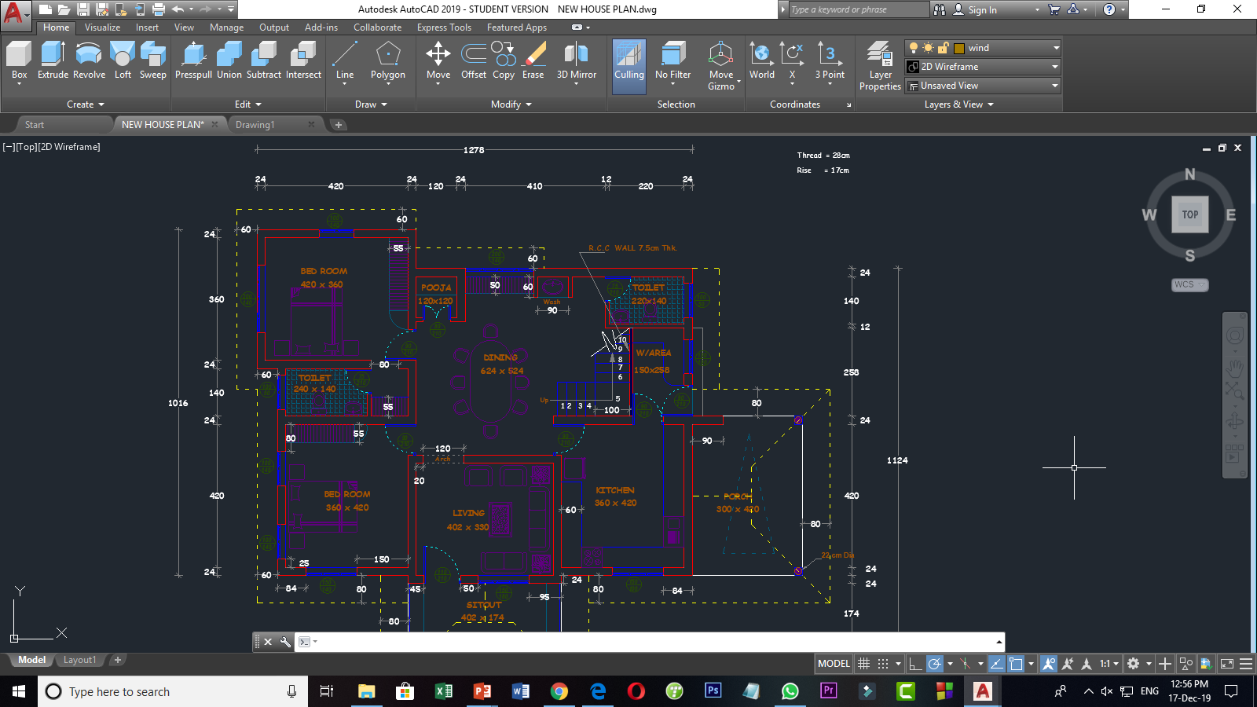
Step 2: (Proper Planning)

Slide 10
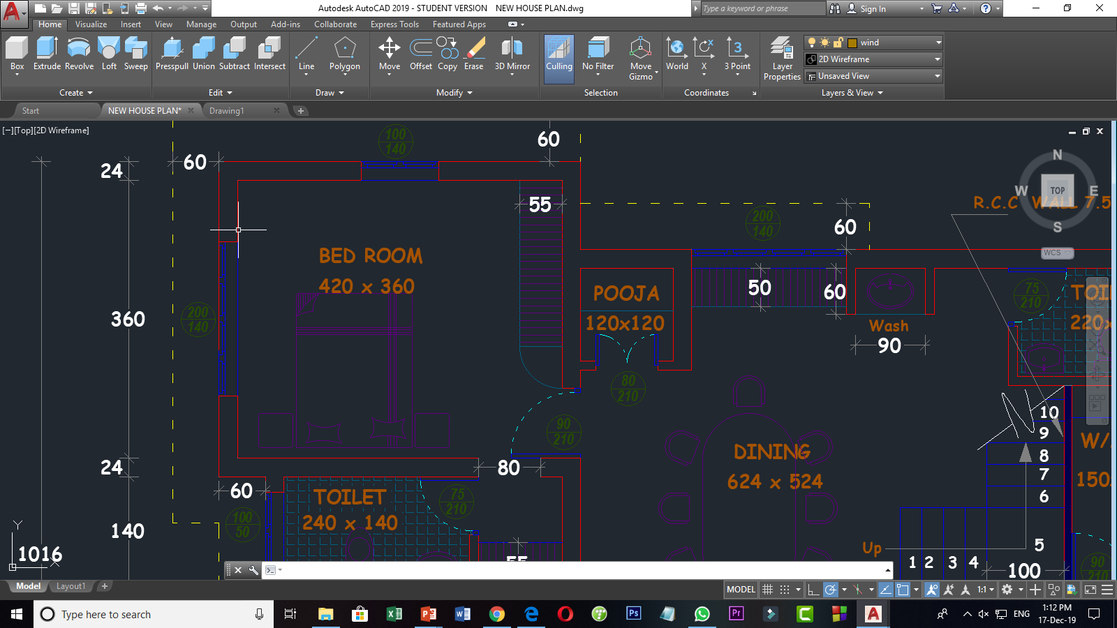
Step 3: Bed Room

Slide 11
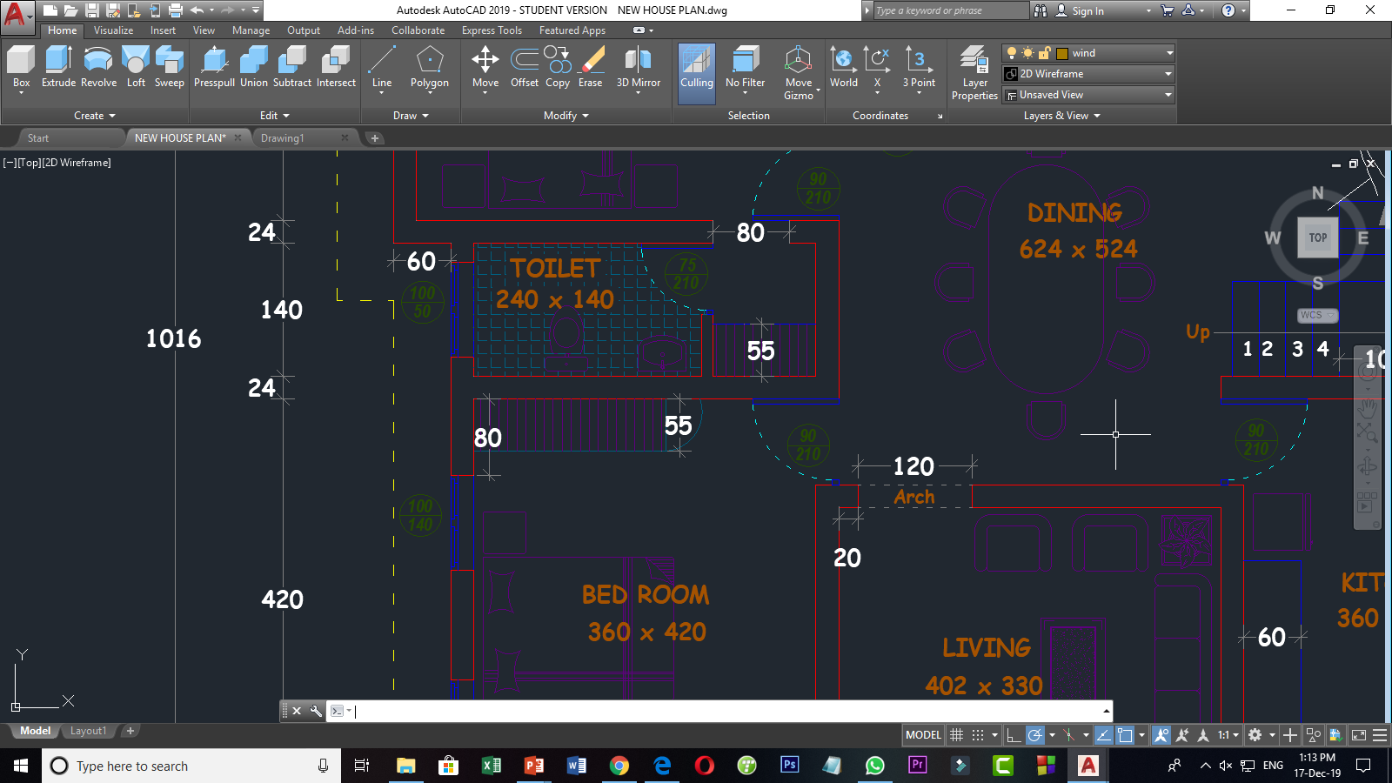
Step 4: Living Room, Toilet, Dining

Slide 12
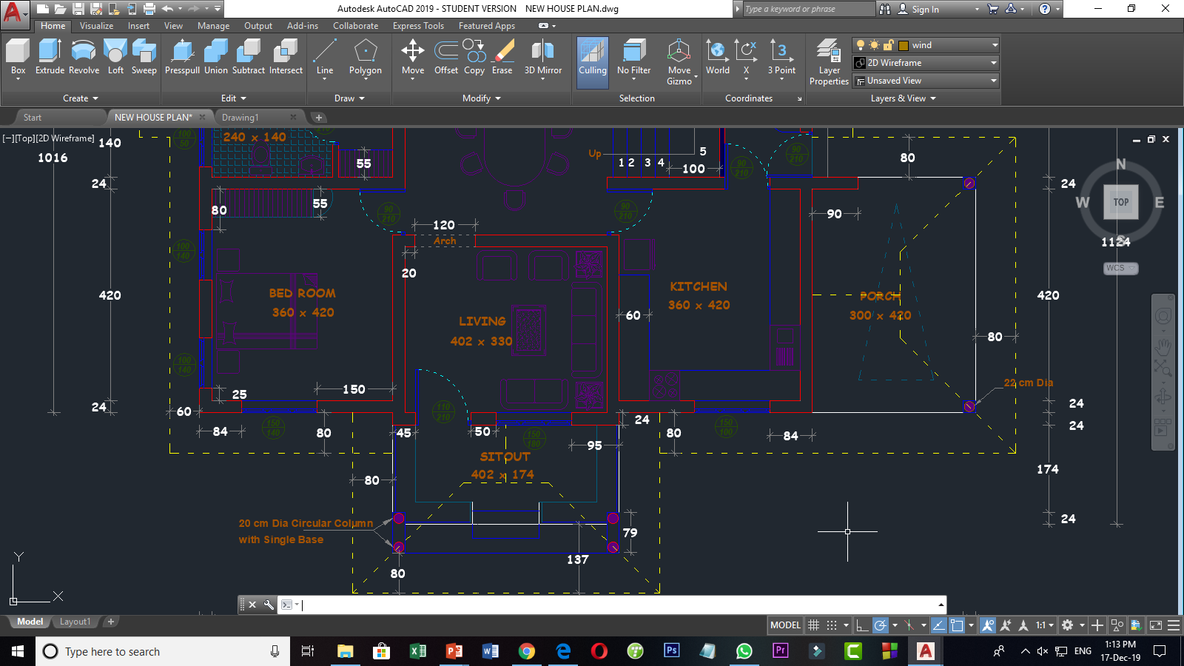
Step 5: Living Room, Kitchen, Porch & Sitout

Slide 13
Step 6: Ready for Convert 3D Mode

Slide 14
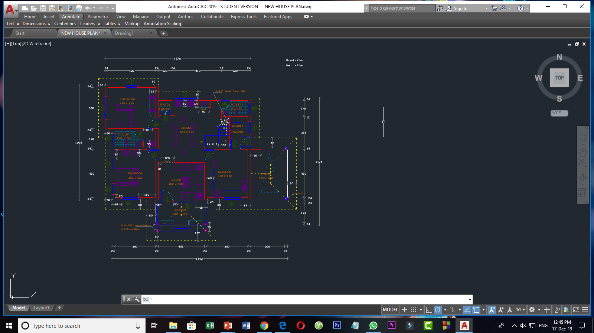
Step 7: Let’s Convert 3D Mode

Slide 15
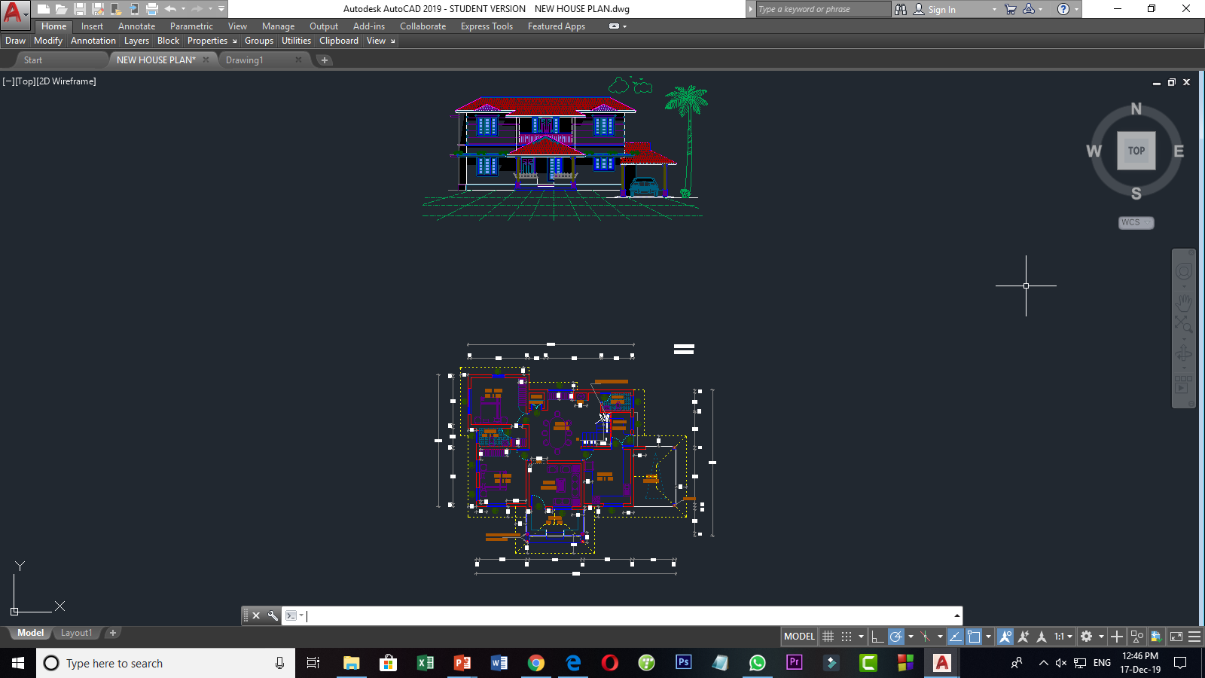
Step 8: 3D Mode

Slide 16
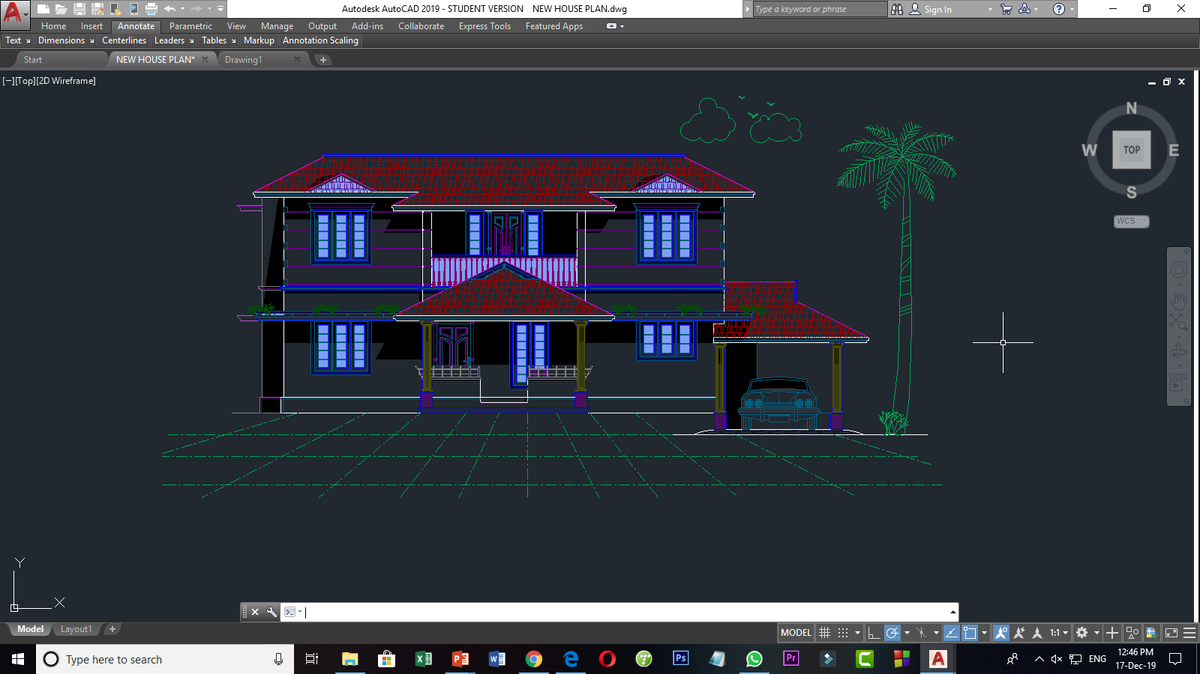
Step 8: Expected 3D House

Slide 17



Reference
https://www.youtube.com/watch?v=zgj-0wyfAmE
https://youtu.be/5KzWACtyocs

Slide 18
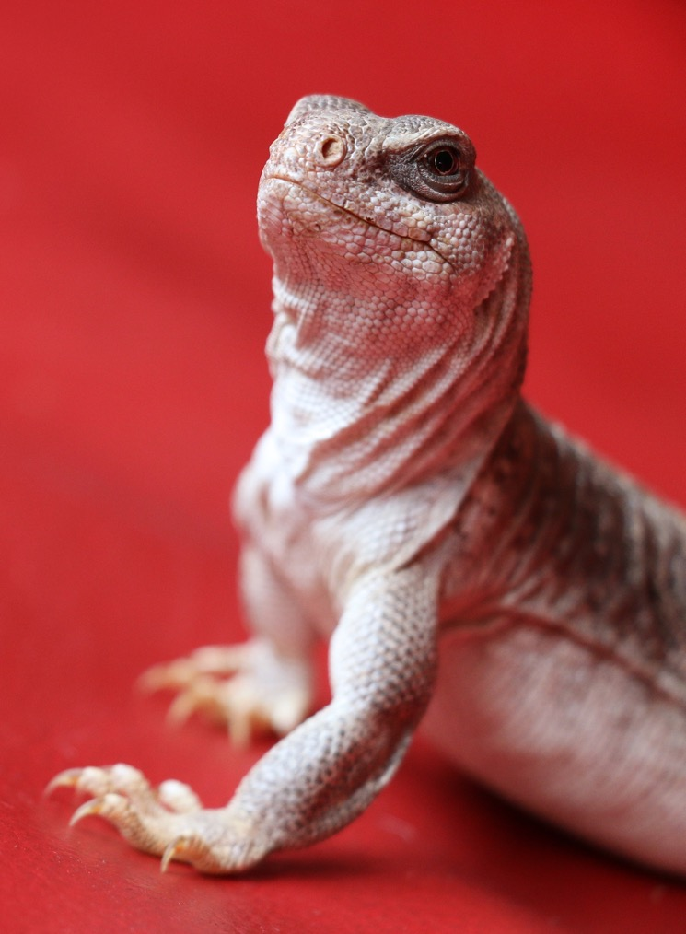


Slide 19


